Slide 2
Stata: Descriptive Analysis with Tables
Ankriti Singh
Research Consultant

Slide 3
Outline
Descriptive Statistics
Summary tables
Balance tables
Regression tables

Slide 4
Overview: Stata Labs
Introduction to Stata
Data Cleaning & Tidying
Descriptive Analysis with tables
Descriptive Analysis with graphs

Slide 5
Today’s lab
Introduction to Stata
Data Cleaning & Tidying
Descriptive Analysis with tables
Descriptive Analysis with graphs

Slide 6
Data Analysis
Input
One or multiple constructed datasets
Steps
Exploratory analysis: Explore, describe and look for patterns in the data
Final data analysis: Create and export polished tables and graphs
Output
Excel tables
PNG or JPG images
Documentation

Slide 7
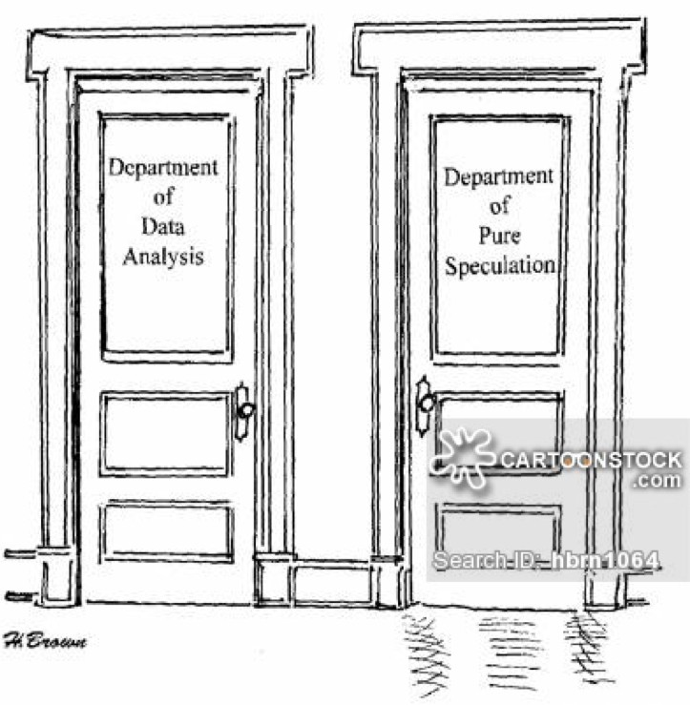
What are Descriptive Statistics?
Numbers or figures that paint a picture of what a given dataset looks like
They begin to help us understand the important features of our dataset, and can be useful in directing us towards areas of further analysis

Slide 8
Describing data using tables
There are different ways to describe data using tables:
Summary statistics
Balance tables
Regression tables

Slide 9
Setting the stage
Launch Stata
Open lab3.do
Load the clean dataset TZA_CCT_baseline_clean.dta

Slide 10
Summary Statistics

Slide 11
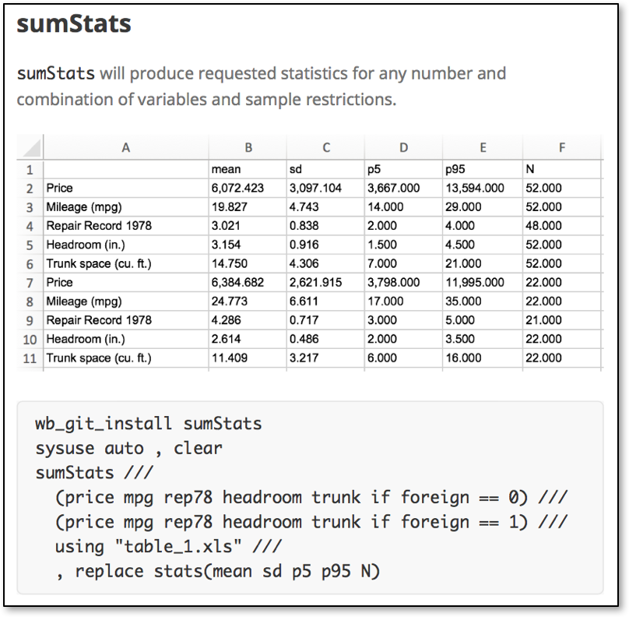
Summary Statistics
Summary statistics appear in almost every research product
Used to highlight central tendencies (means/medians)
Describe variation in data and comparison groups (SE/SD)
Indicate ranges and outliers (quantiles and observation numbers)

Slide 12
Task 1A: Summarize
Use summarize to explore total cost of treatment and share of households with atleast one member sick in the last 4 weeks
What share of households at atleast one sick member in the last 4 weeks?
Use tabulate to explore the variables the first crop grown and the purpose of the first crop
Use tabulate to explore relationship between crop_1 and crop_prp_1
Which crop is mainly used for food?
Which crop is mainly used for sale?

Slide 13
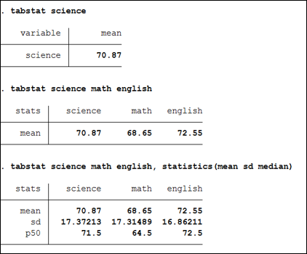
Summary Statistics: tabstat
tabstat is a useful command that can provide summary statistics for a series of numeric variables in one table
It allows you to specify the list of statistics to be displayed
By default, it only displays mean
Statistics can be calculated (conditioned on) another variable

Slide 14
Task 1B: Summarize using tabstat
Create a global called sum_vars that stores the variables to be summarized:
household size,
number of children, adults, and elders,
number of livestock now
area in acres
whether household experienced drought
whether household experienced crop damage
Use tabstat to create a table of mean of these variables
Use the global you created

Slide 15
Task 1C: Add more stats
Create another table displaying the mean, standard deviation, the median, and the number of observations for these variables
Use statistics(stats)option
Display these statistics separately for female and male headed households
Use by(varname)option
Use columns(statistics)option to display stats in columns

Slide 16
Exporting tables
Some commands used to export tables in Stata:
estout and esttab: A user-written command that creates customizable tables of regression results or summary statistics, allowing you to combine and format results from multiple models and export them in various formats
estpost: To store estimation results from other estimation commands (e.g., summarize, tabstat, etc.)
eststo: To store estimation results from multiple models and recall them later for comparison or combination using esttab or other post-estimation commands.
Install estout from SSC

Slide 17
Task 1C: Export summary statistics
Use espost to store the results of the tabstat command from the previous task
estpost tabstat $sum_vars, by(varname) s(stats) c(statistics)
Use esttab to export the results to Datawork/Outputs
Use cell() option to specify the statistics to be exported
esttab using “filepath/table1.csv”, replace cell((stats))
Open the exported csv to look at the results
Are the variable names informative?
Use label option with the esttab command above to export the table with variable labels instead of variable names

Slide 18
Task 1D: Use sumstats
Install the command sumstats
Check the helpfile to export a summary table of the same variables for the whole sample, and by the households that reported having a health committee in the village or not
sumstats (varlist_1 [if]) [(varlist_2 [if])] [...]
using "/path/to/output.xlsx" [weight], stats(stats_list) [replace]

Slide 19
Balance tables

Slide 20
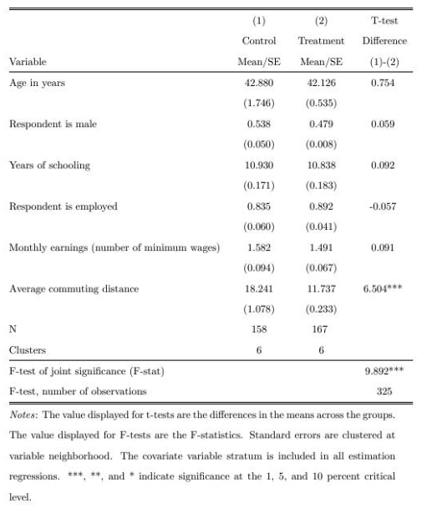
Balance tables
Balance tables appear in almost every RCT research product
Used to indicate which groups comparisons are drawn across
Describe variation in each comparison group
Summarize differences (or lack thereof) between groups

Slide 21
Balance tables in Stata
iebaltab is an SSC command in the ietoolkit package that allows you to quickly create balance tables in various formats
iebaltab balancevarlist, groupvar(varname)
where balancevarlist is one or several continuous or binary variables (from here on called balance variables) for which the command will test for differences across the categories in groupvar(varname)
Install ietoolkit package from SSC if you haven’t yet
Check the help file for more options

Slide 22
Task 2: Create Balance Table
Use iebaltab to create a balance table that compares the same variables stored in global sum_vars across treatment and and control villages
Use savexlsx(filename) option to save the table to an excel sheet
Use rowvarlabels option to use variable labels instead of variable names
What similarities and differences are indicated?

Slide 23
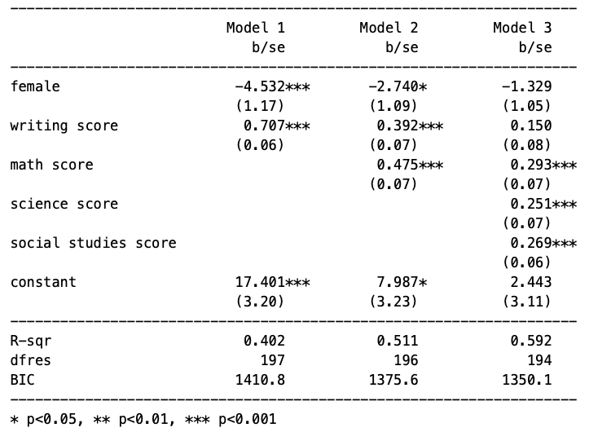
Regression tables
Regression tables appear in almost every academic research product
Used to indicate the exact comparisons being drawn in research
Describe control variables and outcomes for each model
Contextualize comparisons with more information

Slide 24
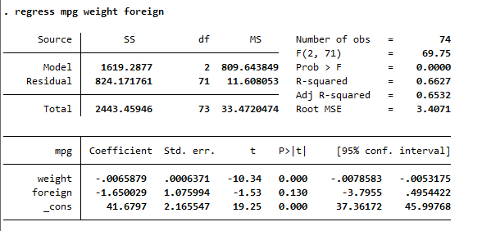
Regressions in Stata
In Stata, you can use the regress command to run linear regressions:
regress depvar [indepvars] [if] [in] [weight] [, options]

Slide 25
Task 3: Create Regression table
Construct a regression table with 3 models:
Model 1: Start with a basic regression model. Use regress to see whether Treatment predicts annual food consumption
Model 2: Add controls for whether any member can read/write
Model 3: Add clustering by village
Use eststo after each model to store the results
regress depvar indepvar
eststo model#
Use esttab to export a table with these three regression models side-by-side
esttab model1 model2 model3 using “filepath/table3.csv”, replace label

Slide 26
Summarizing data with collapse
The collapse command that we used to make community level data is also useful to create descriptive tables
The easiest way to export a descriptive table to Excel is to collapse the dataset, create the columns we want to present in our table, and export the entire dataset to Excel

Slide 27
Task 4: Summary with collapse
Use collapse to create a summary table with following statistics by treatment:
Average food consumption value
Average treatment cost
Average area cultivated
Total members
Total livestock now
Total households
Label and order the variables
Use format to format the numeric variables so they have 2 decimals
Export as excel using export excel

Slide 28
Checklist for tables
Does the number of observations for each regression or summary statistic make sense?
Do the magnitude and sign of each coefficient/summary statistic seem reasonable?
Did you label all the variables/columns/rows?
Did you add a title?

Slide 29
Recap
We learned how to:
Create and export summary tables
Importance of balance tables in RCTs and how to create them
Running regressions and exporting them to a table
Best practices for creating tables

Slide 30
Thank you!

Slide 31
Further Reading
https://dimewiki.worldbank.org/Data_Analysis
https://github.com/worldbank/stata-tables
https://github.com/worldbank/DIME-LaTeX-Templates
https://dimewiki.worldbank.org/Checklist:_Submit_Table
https://dimewiki.worldbank.org/Exporting_Analysis

Slide 32
Task 5: Summary by enumerators
Ensure consistency in data collection across all enumerators by:
Selecting a list of variables critical for assessing data quality
Use collapse to export a summary of these variables by enumerator. You can employ metrics such as averages, sums, or counts to evaluate enumerator performance.
Additionally, be vigilant to detect any anomalies or irregular values submitted by enumerators.

